Slide 1
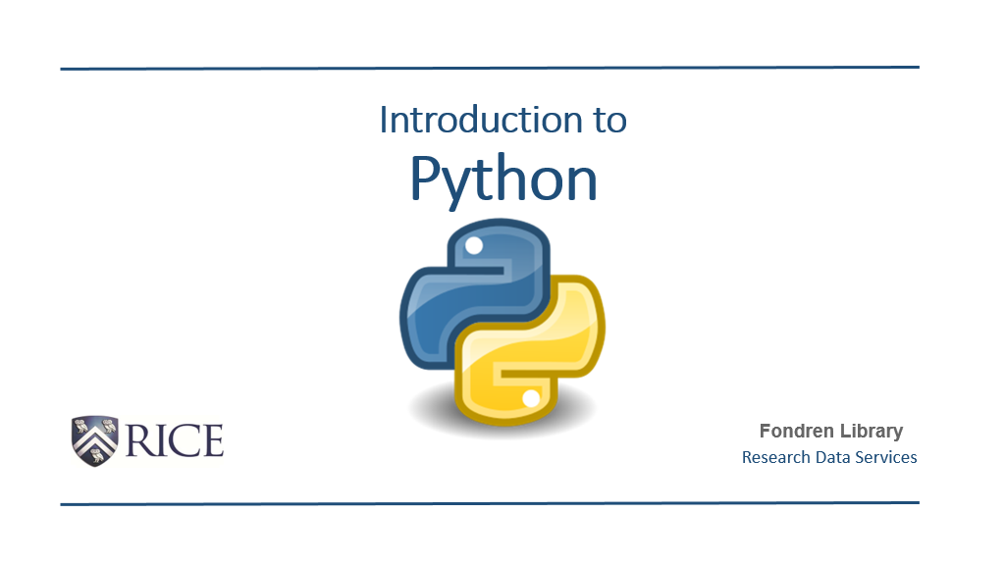


Slide 2
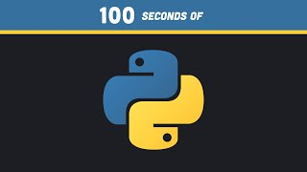

Slide 3
Terminology
Library: A library is a collection of modules that includes pre-written code (code blocks) to help with common tasks.
Modules: Established and External Tools that serves a specific function, such as file handling, data analysis, web development.
Import: Allows one to bring in modules to execute a specific module or library (package) in your coding environment (env).
Function: Is a reusable block of code that performs a specific task. Functions input, process, and return a specific output.
Variable: A variable is a name that refers to a value that is stored overtime in a computer’s memory. It is used as a label for a piece of data, that allows you to manipulate the data in your code.
Classes (Python): Define what objects are used for, and also, the types of behaviors and processes that can be executed by an object.
Objects: An instance of a class (modules, variables, etc), that has an attached set of attributes and behaviors, with specific types of conditions that can be executed from that block of code.

Slide 4
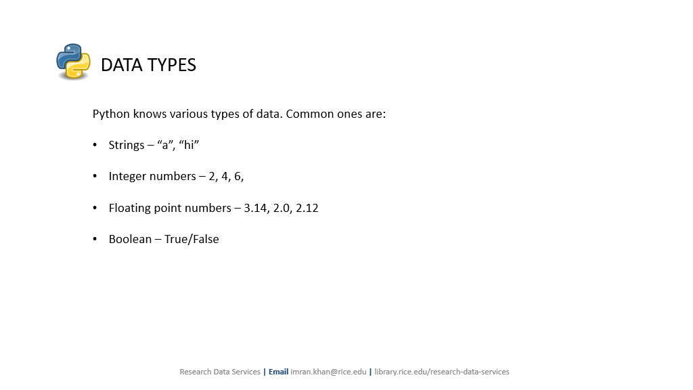

Slide 5
Strings - Used to represent text in our coding blocks.
Ex. print(“Hello World”)
Integers (int) - Whole Numbers that don’t have fractional components (ex. No decimals or fractions).
Ex. sum = 42 + 76
print(sum)
Floating Point Numbers (floats) - are used to represent numbers with decimal points (also show fractional numbers such as 1/4, 5/2, 8/10).
Ex. pi = 3.14
print(pi)
Boolean Values (bool/bools) - True or False Values | Computer represents as true or absent of true values (false)
Ex. is_student = False
print(is_student)

Slide 6
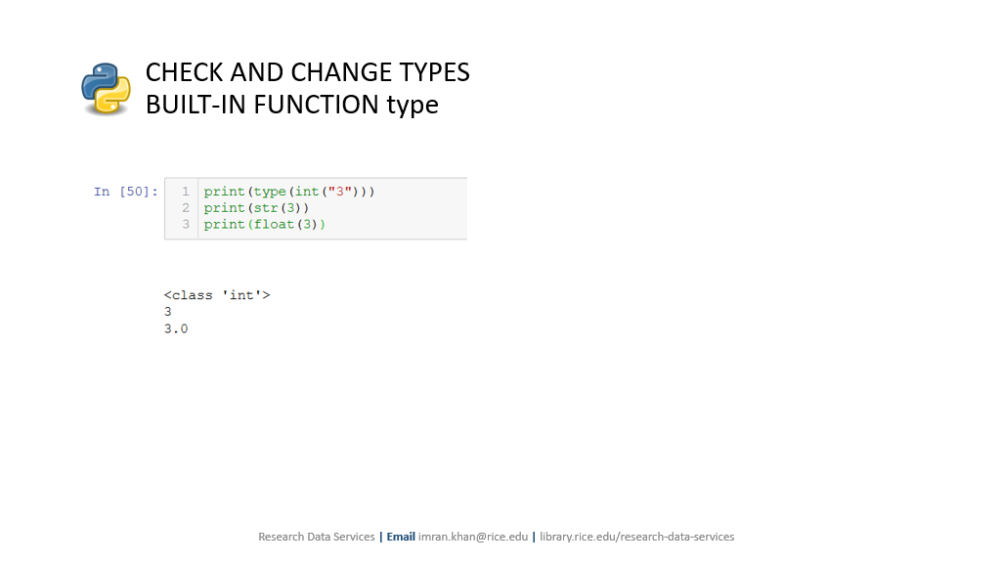

Slide 7
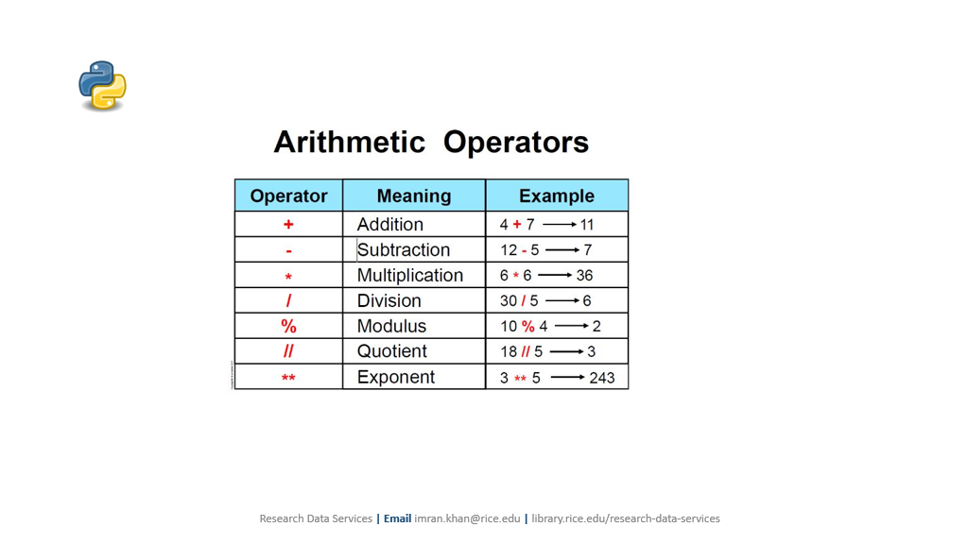
Operands - Characters, symbols, strings, objects that are being operated on

Slide 8
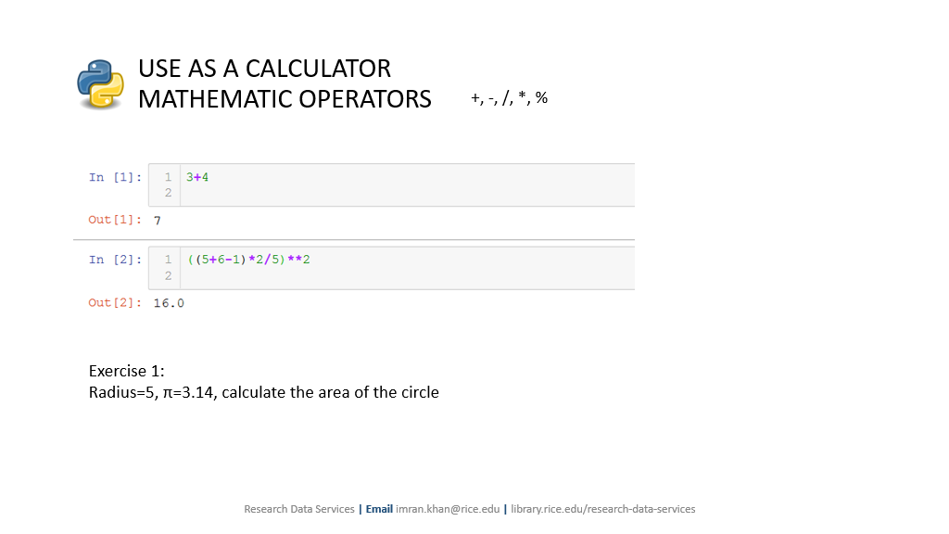
radius = 5
pi = 3.14159265359
area = pi * radius * 2
print("The area of the circle is:", area)

Slide 9
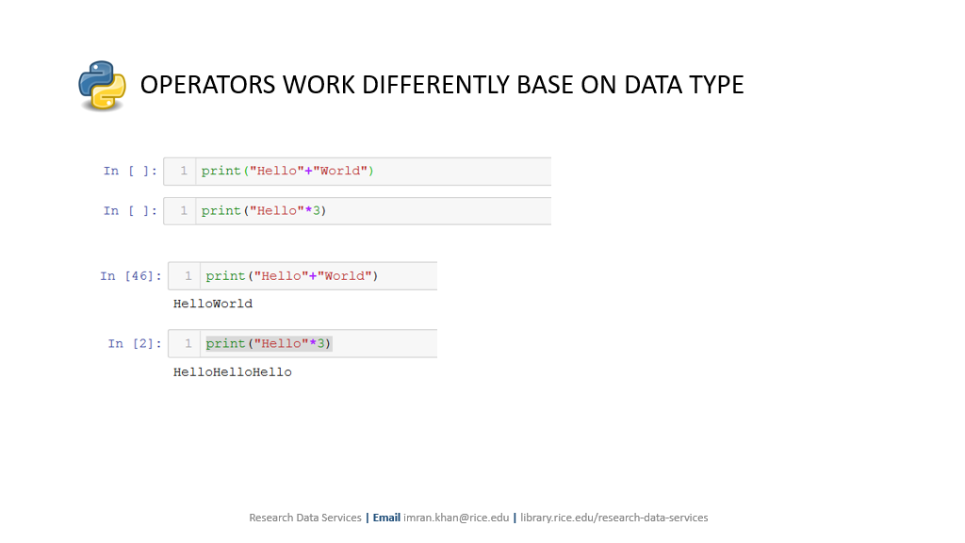

Slide 10
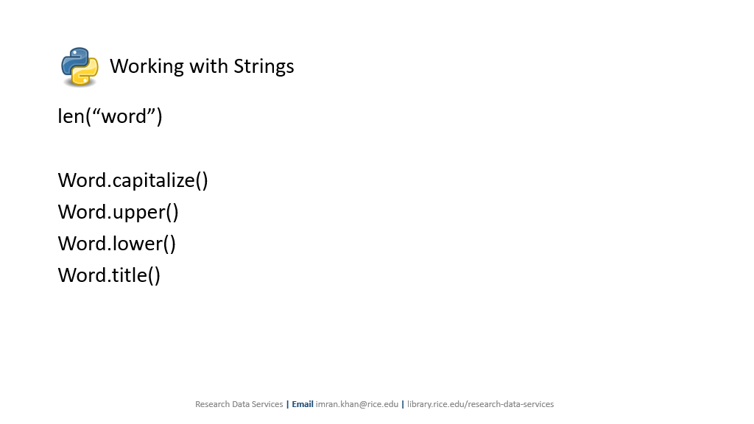

Slide 11
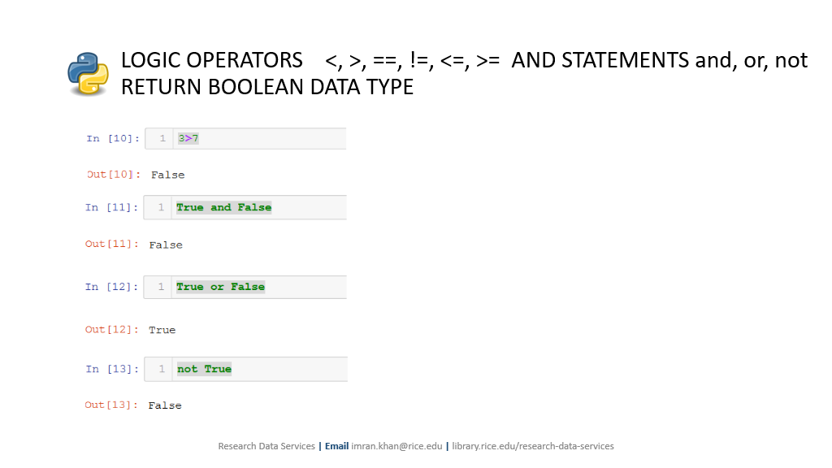

Slide 12
Logical Operators/Statements (Relationships between operands or values)

Slide 13
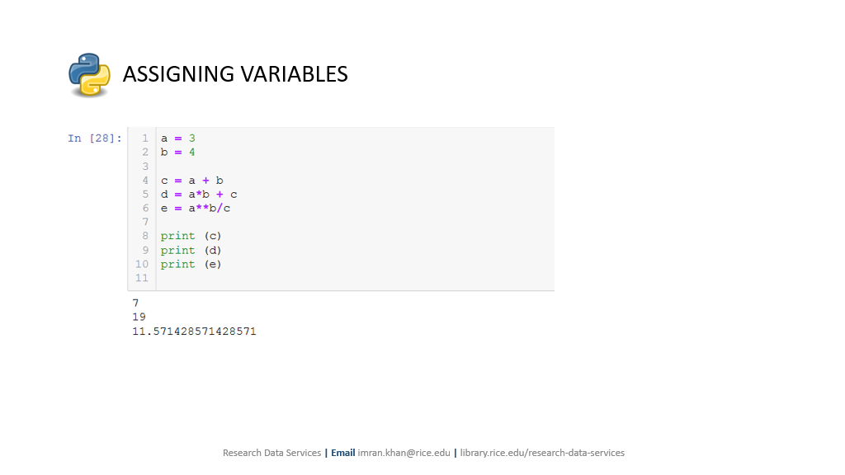

Slide 14
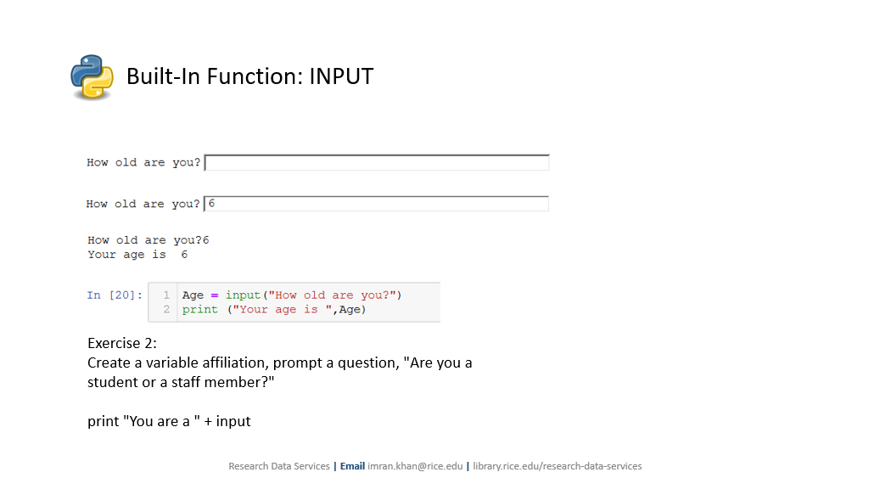

Slide 15
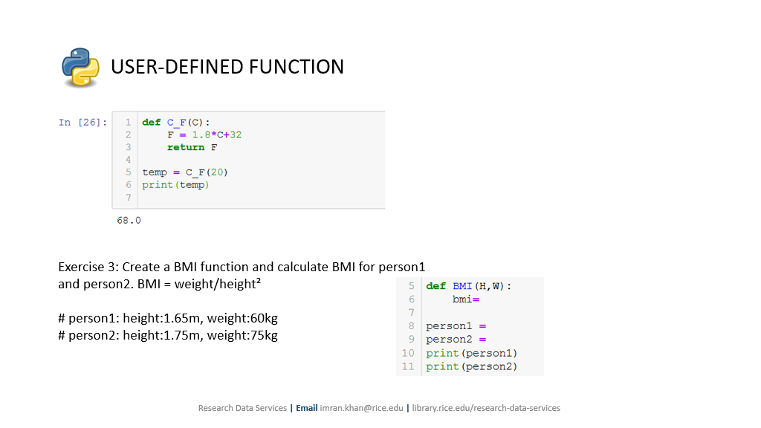

Slide 16
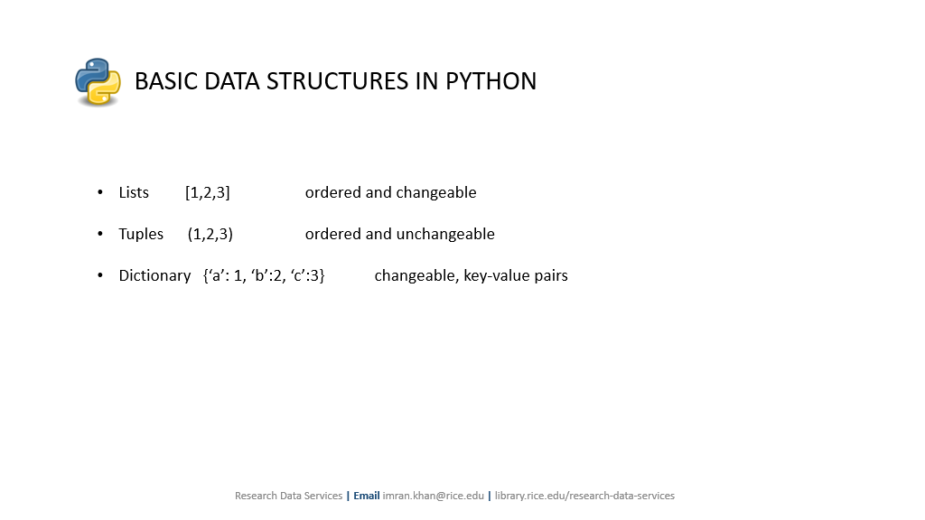

Slide 17
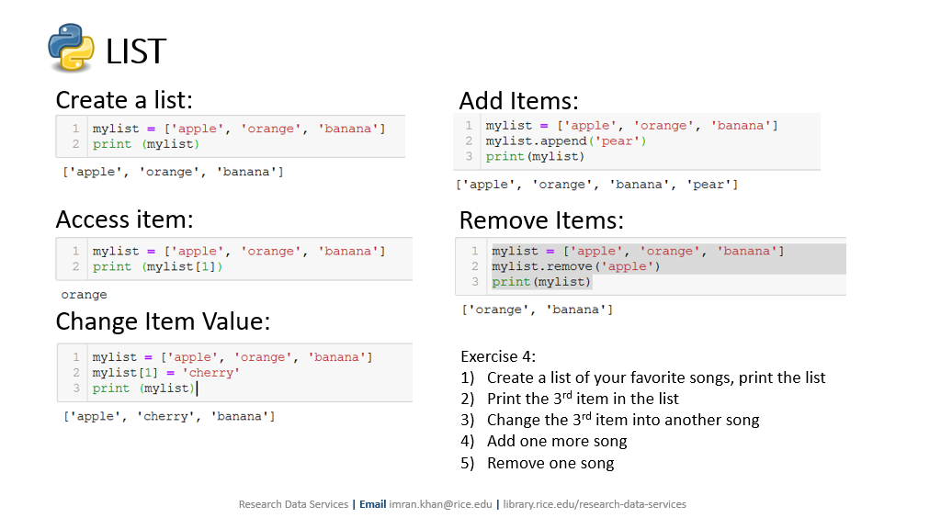

Slide 18
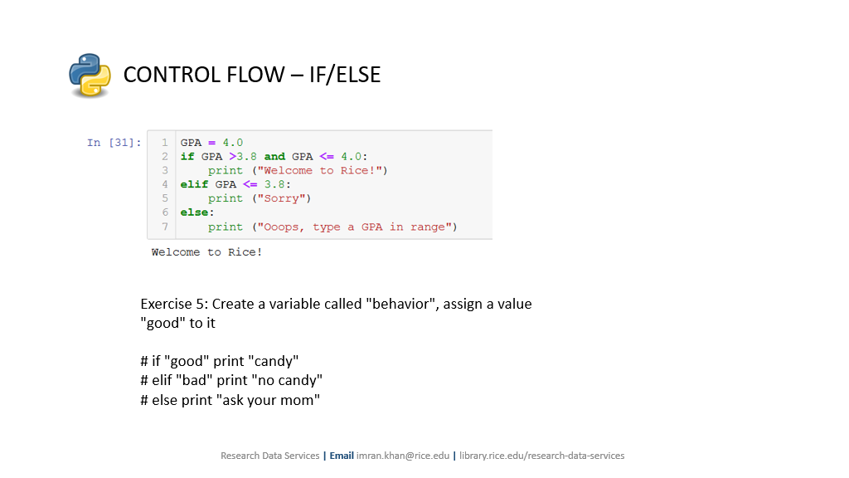

Slide 19
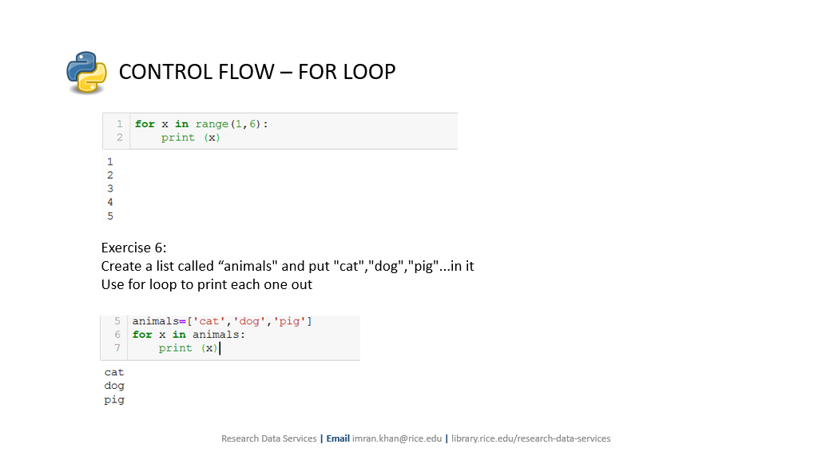
def bark():

Slide 20
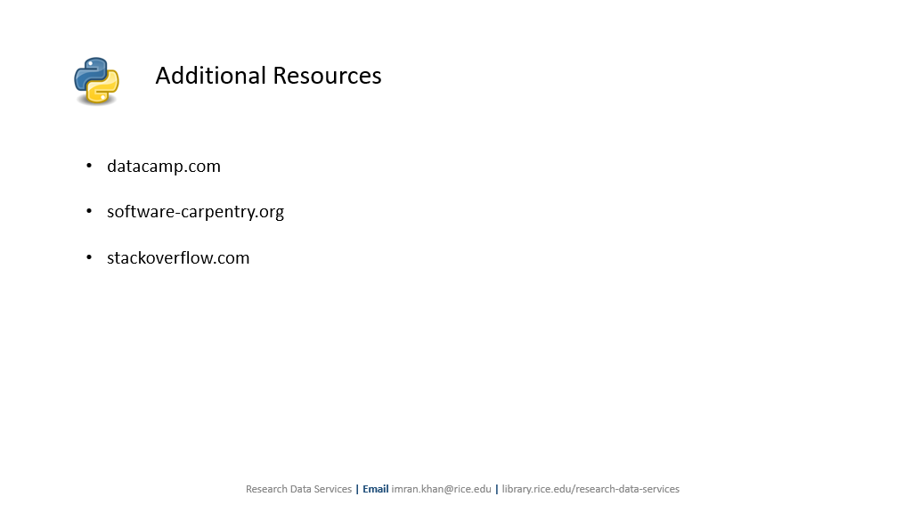

Slide 21
Office Hours - 8PM to 9PM

